Slide 1

Module 5: Model Selection and Regularization
Oct 8th, 2021

Slide 2
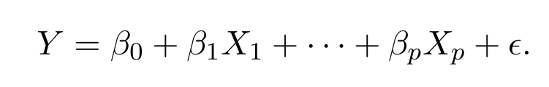
Linear Models
The linear model has advantages in terms of its interpretability and often shows good predictive performance.
How to improve linear model? Beyond Ordinary Least Square(OLS)

Slide 3
Why Consider Alternatives to OLS?
Prediction Accuracy: especially when p > n. Need to control variance
Model Interpretability: Small number of features are easier to understand and design experiment.

Slide 4
Three Classes of Methods
Subset Selection. We identify a subset of the p predictors then ﬁt a model using least squares on the reduced set of variables.
Shrinkage. We ﬁt a model involving all p predictors, but the estimated coeﬃcients are shrunken towards zero relative to the OLS estimates. This shrinkage (also known as regularization) has the eﬀect of reducing variance and can also perform variable selection.
Dimension Reduction. We project the p predictors into a M-dimensional subspace, where M < p. This is achieved by computing M diﬀerent linear combinations, or projections, of the variables. Then these M projections are used as predictors to ﬁt a linear regression model by least squares.

Slide 5
Subset Selection
Best subset selection
Stepwise selection

Slide 6
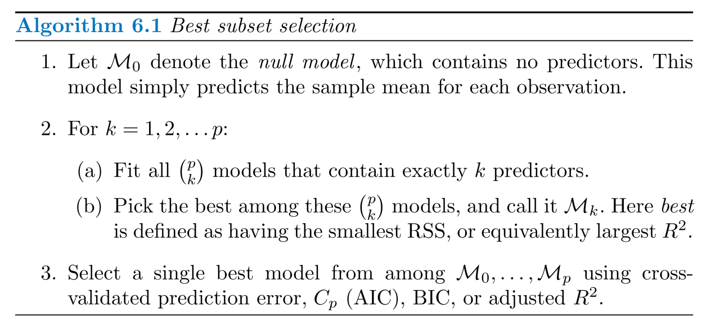
Best Subset Selection

Slide 7
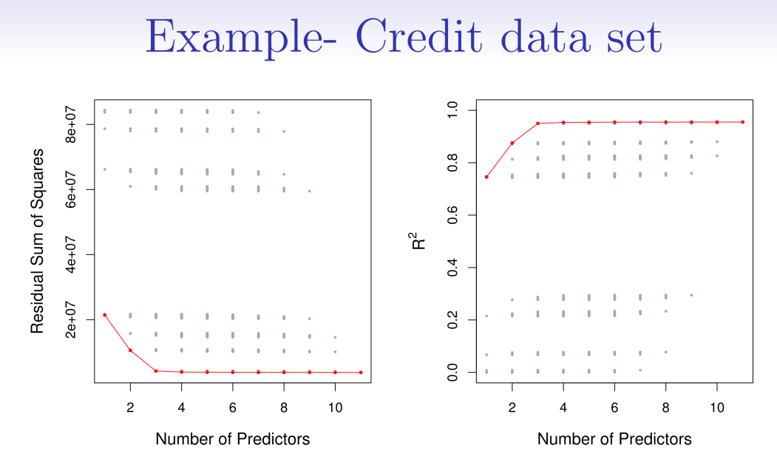
Credit Card Example

Slide 8
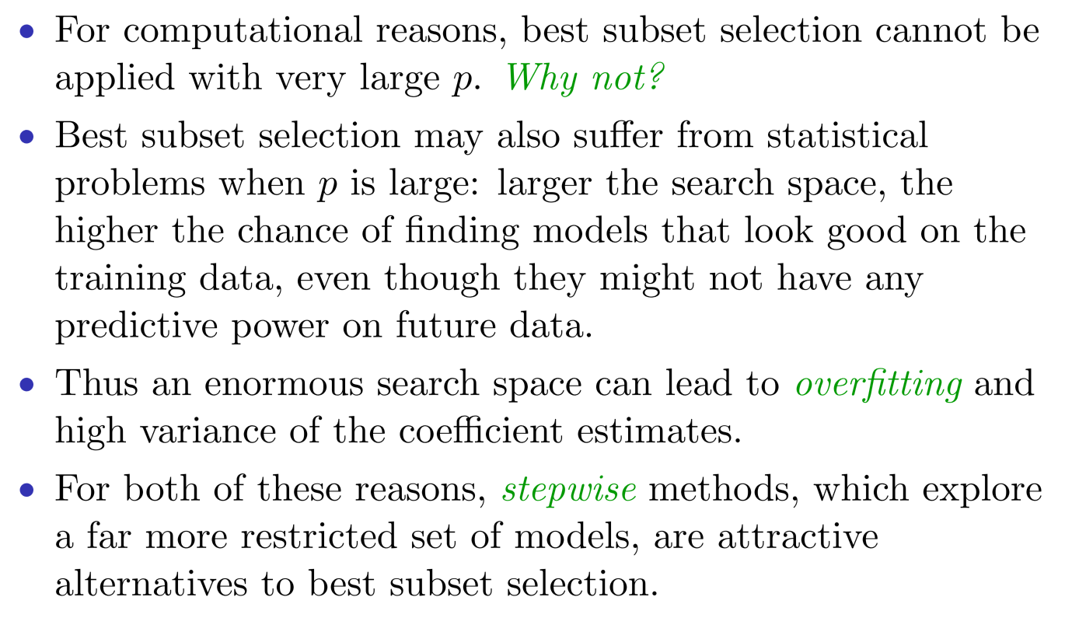
Stepwise Selection

Slide 9
Forward Stepwise Selection
Forward stepwise selection begins with a model containing no predictors, and then adds predictors to the model, one-at-a-time, until all of the predictors are in the model.
In particular, at each step the variable that gives the greatest additional improvement to the ﬁt is added to the model.

Slide 10
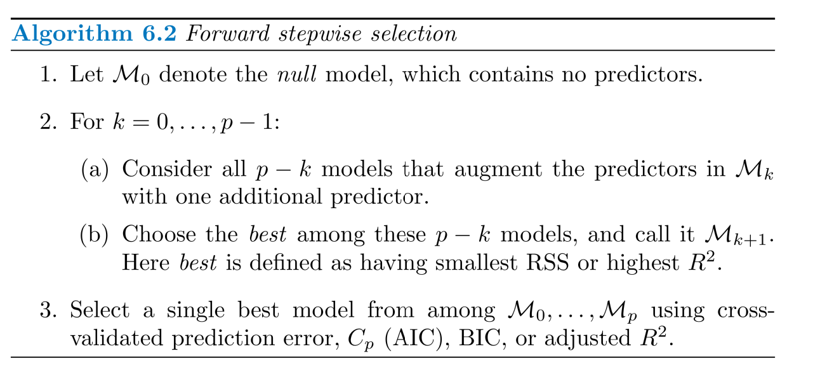
Forward Stepwise Selection

Slide 11
Forward Stepwise Selection
Computational more efficient than best subset selection
Is it guaranteed to find the best possible model?

Slide 12
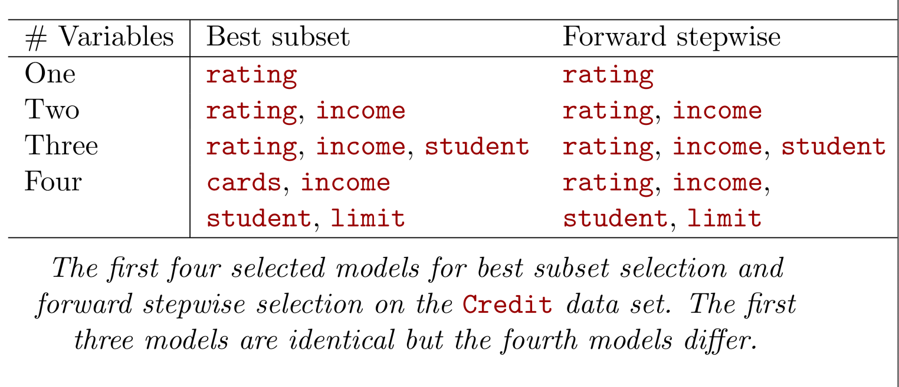
Credit Data

Slide 13
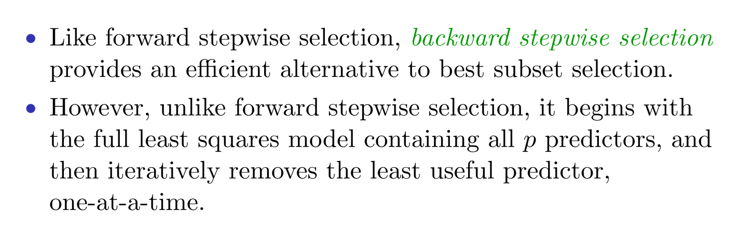
Backward Stepwise Selection

Slide 14
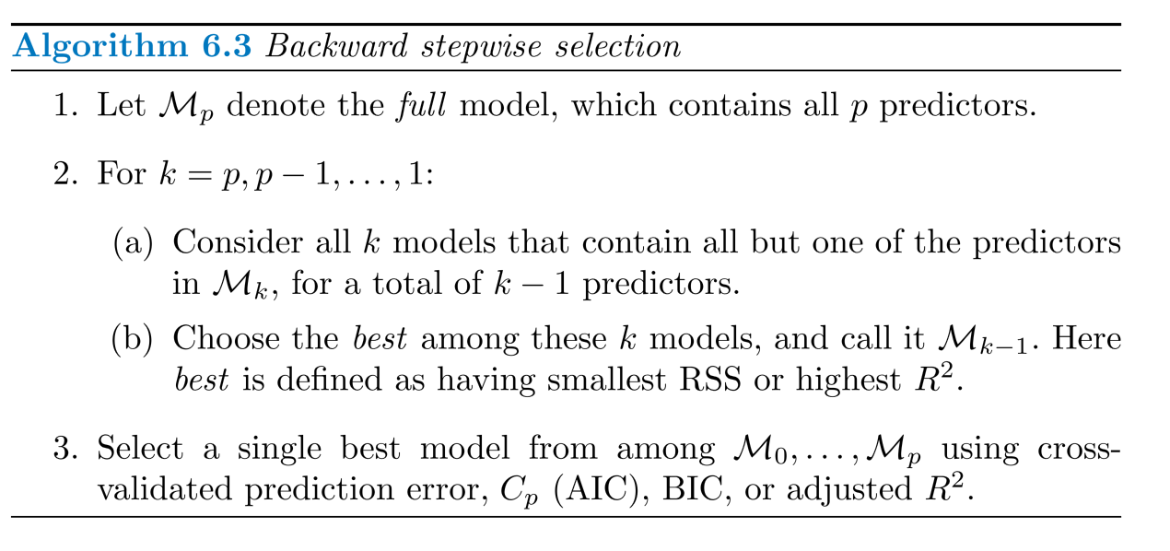
Backward Stepwise Selection

Slide 15
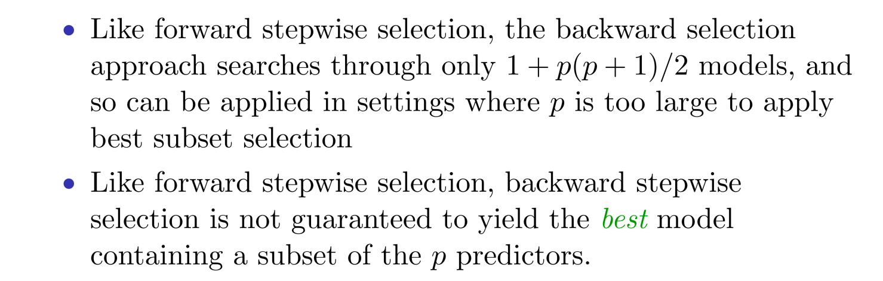
Backward Stepwise Selection

Slide 16
Estimating Test Error
CV is good but very time consuming.
We can indirectly estimate test error by making an adjustment to the training error to account for the bias due overfitting

Slide 17
C_{p}, AIC, BIC and Adjusted R²
These methods adjust the training error for the model complexity.

Slide 18
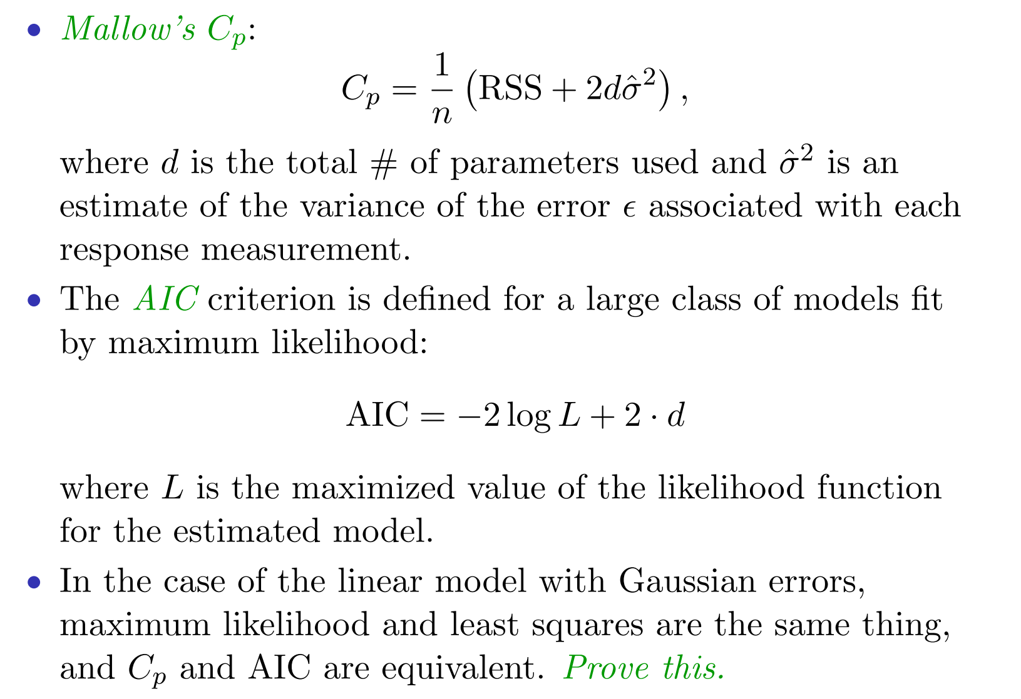
C_{p}, AIC, BIC and Adjusted R²

Slide 19
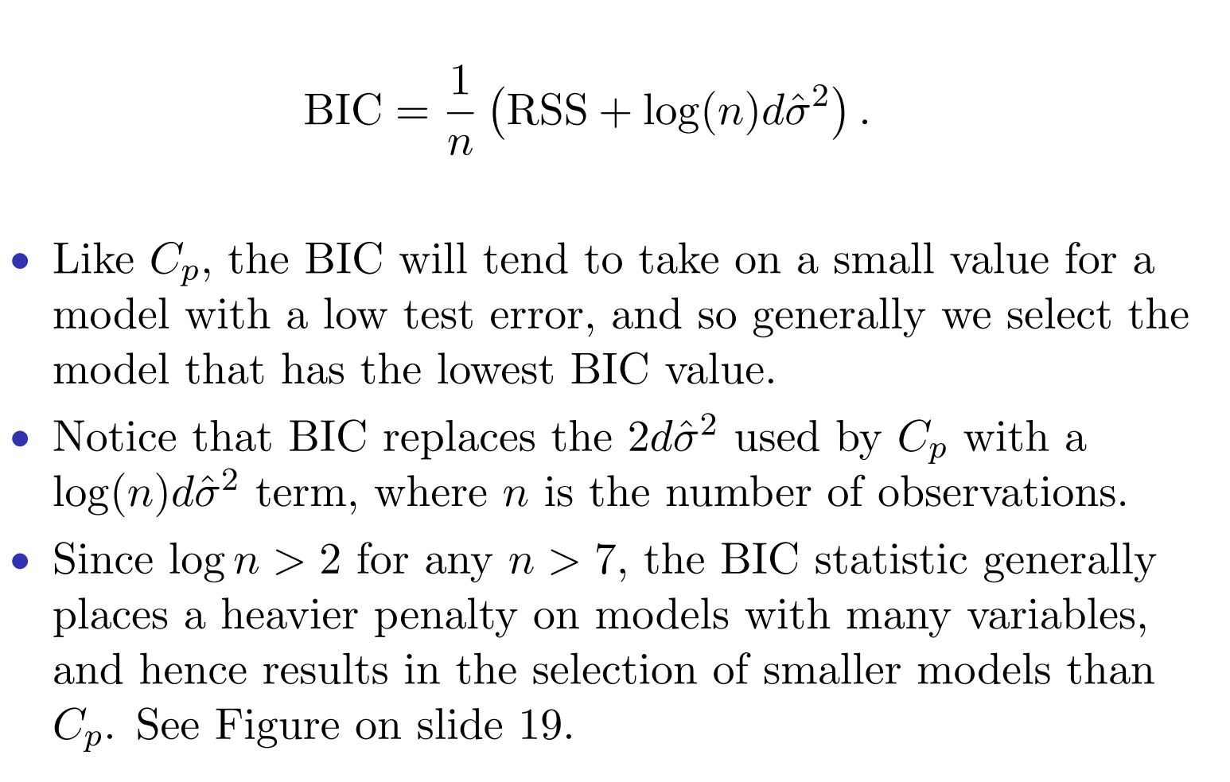
BIC

Slide 20
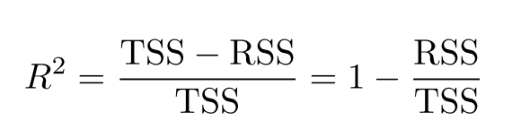
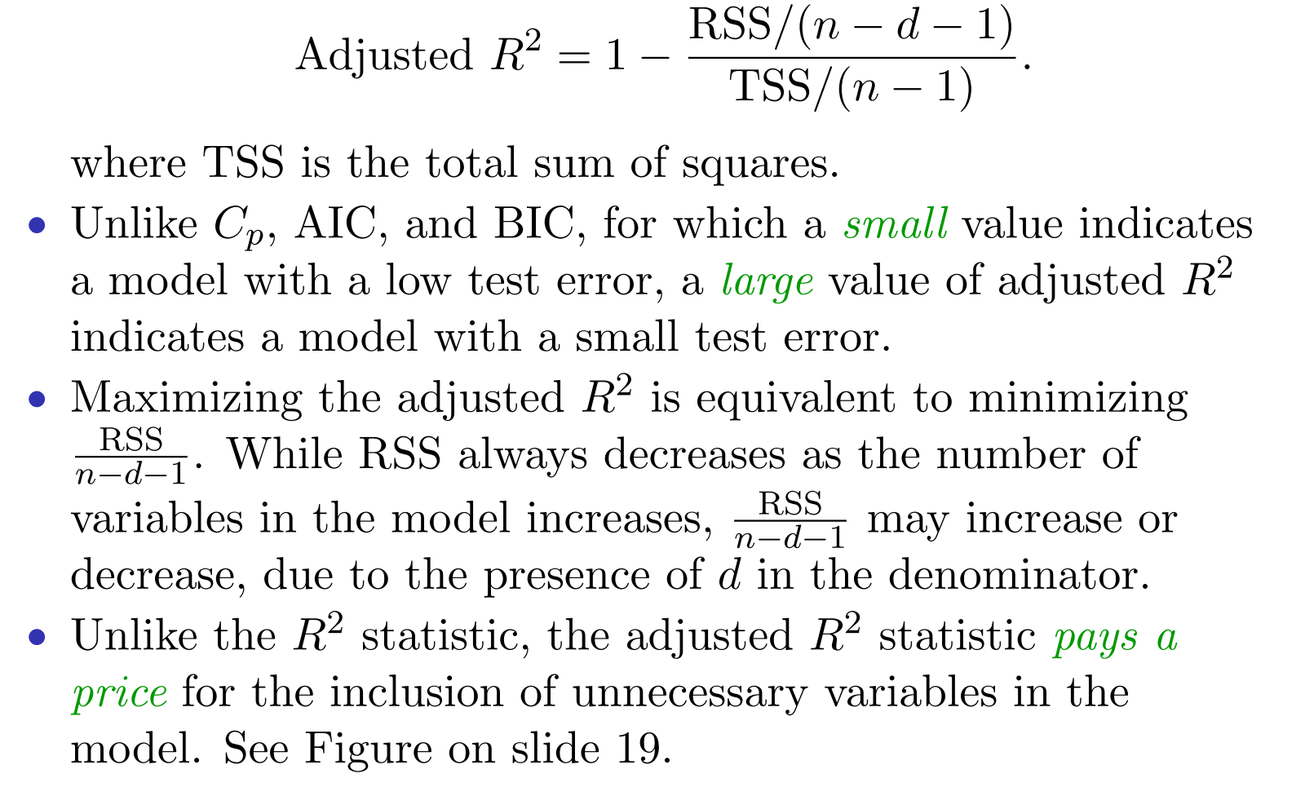
Adjusted R²

Slide 21
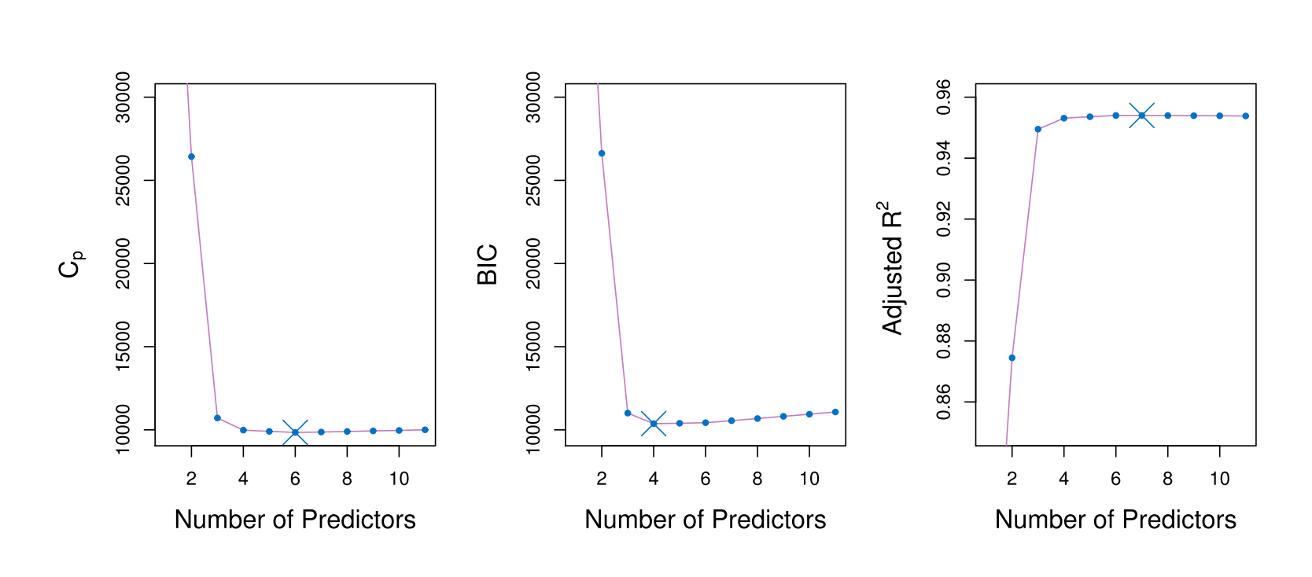
Credit Data Example

Slide 22
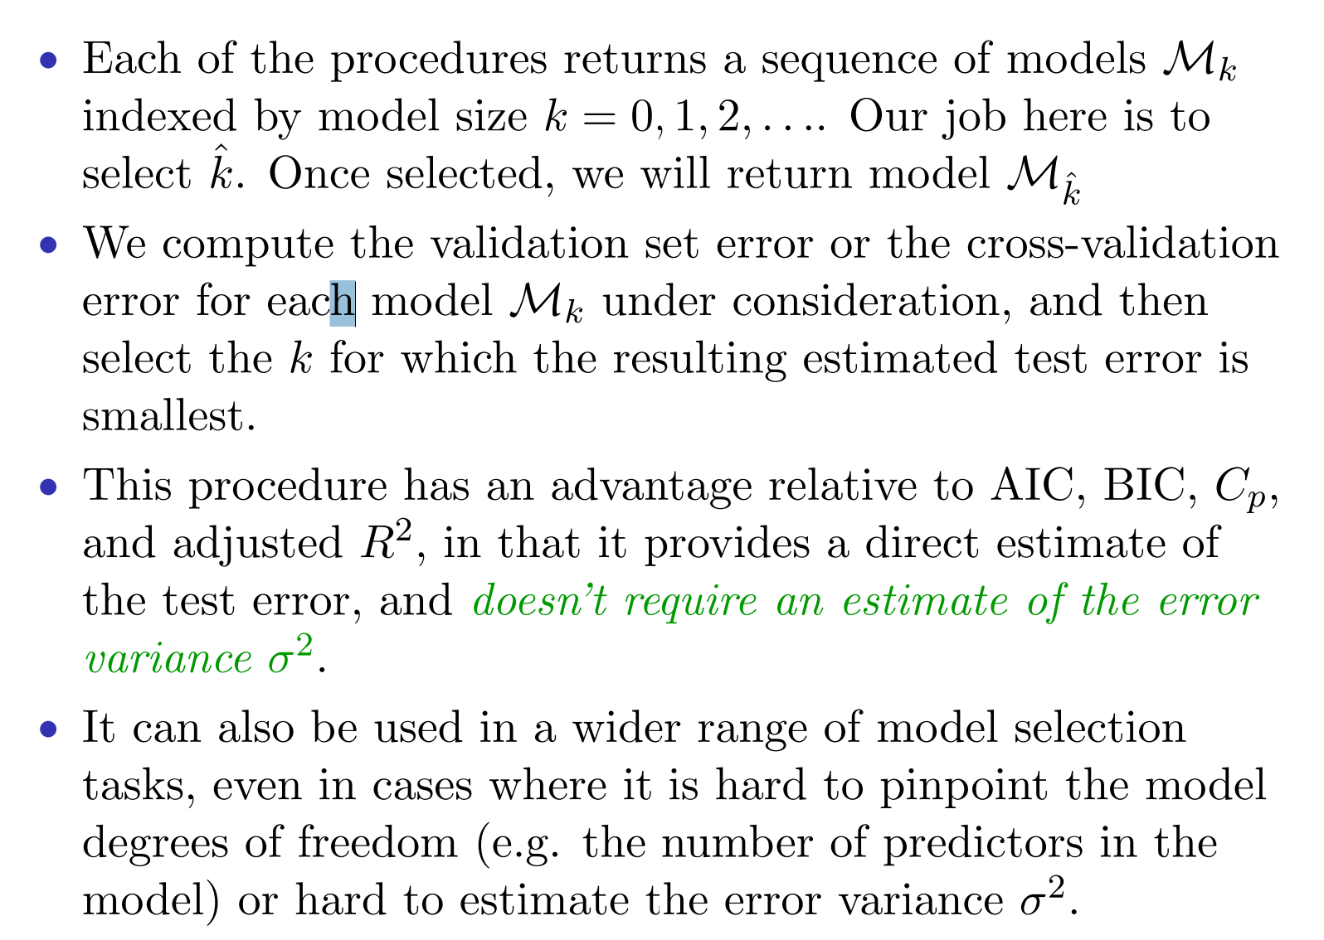
Validation and Cross-Validation

Slide 23
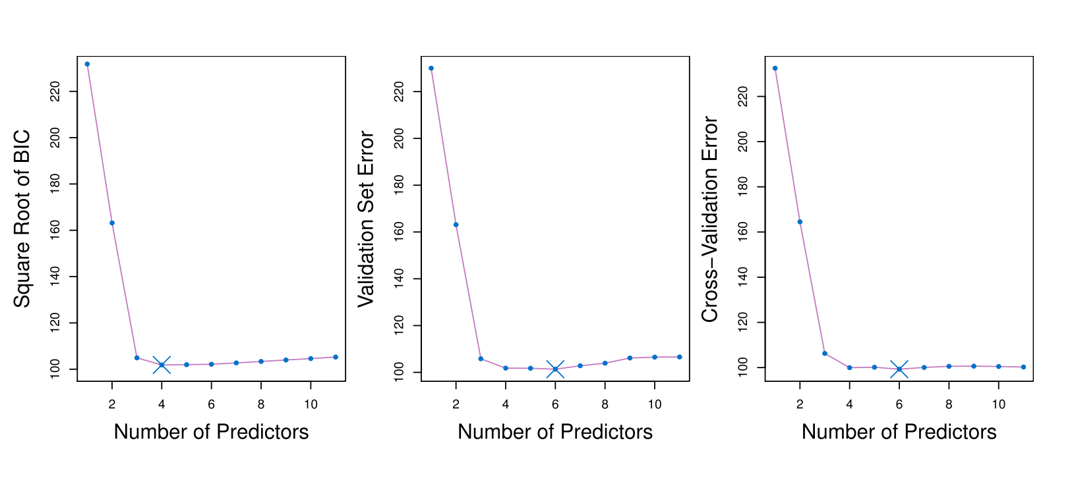
Credit Data Example

Slide 24
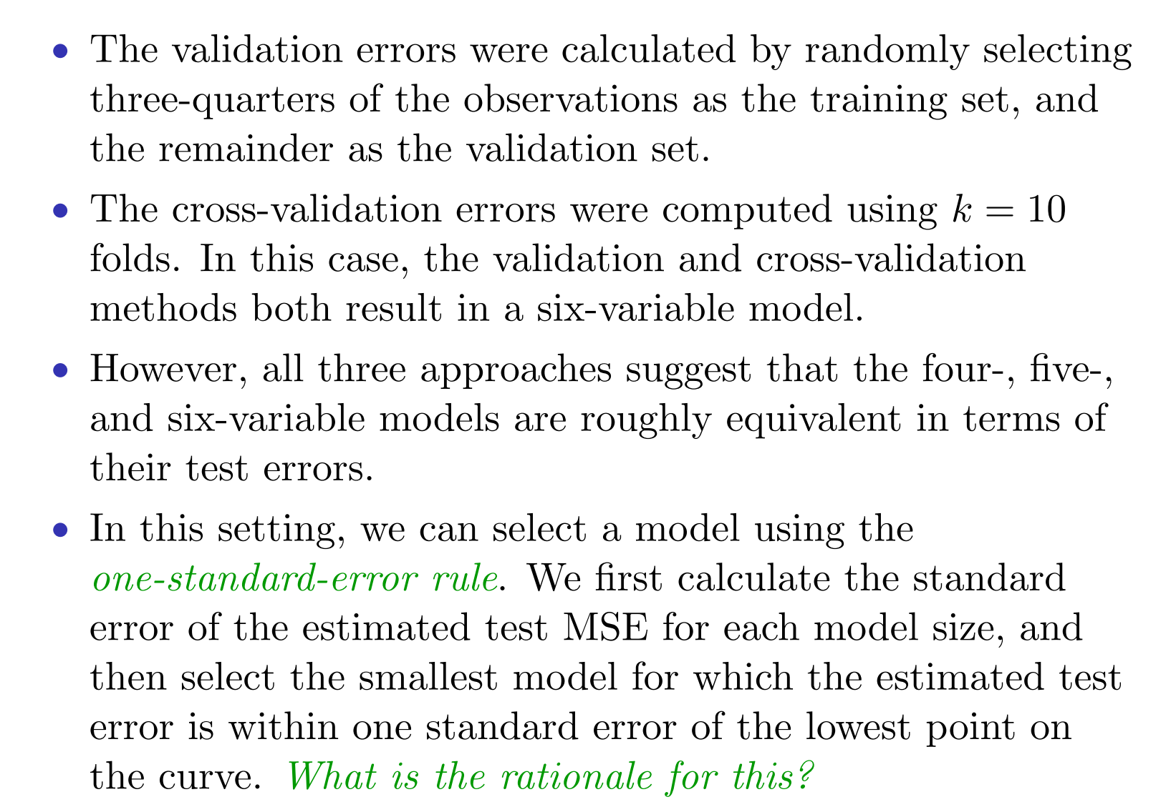
Validation and Cross-Validation

Slide 25
Shrinkage Methods
With large p (number of predictors), bias vs variance
The subset selection will improve the model by reduce the number of predictor and hence reduce ?
We can fit a model containing all p predictors but penalize solutions that use ‘too many’ of the features. This procedure will shrink the coefficient estimates towards zero.
Because we constrain the coefficients, the variances of the estimate will ??. The bias will ??.

Slide 26
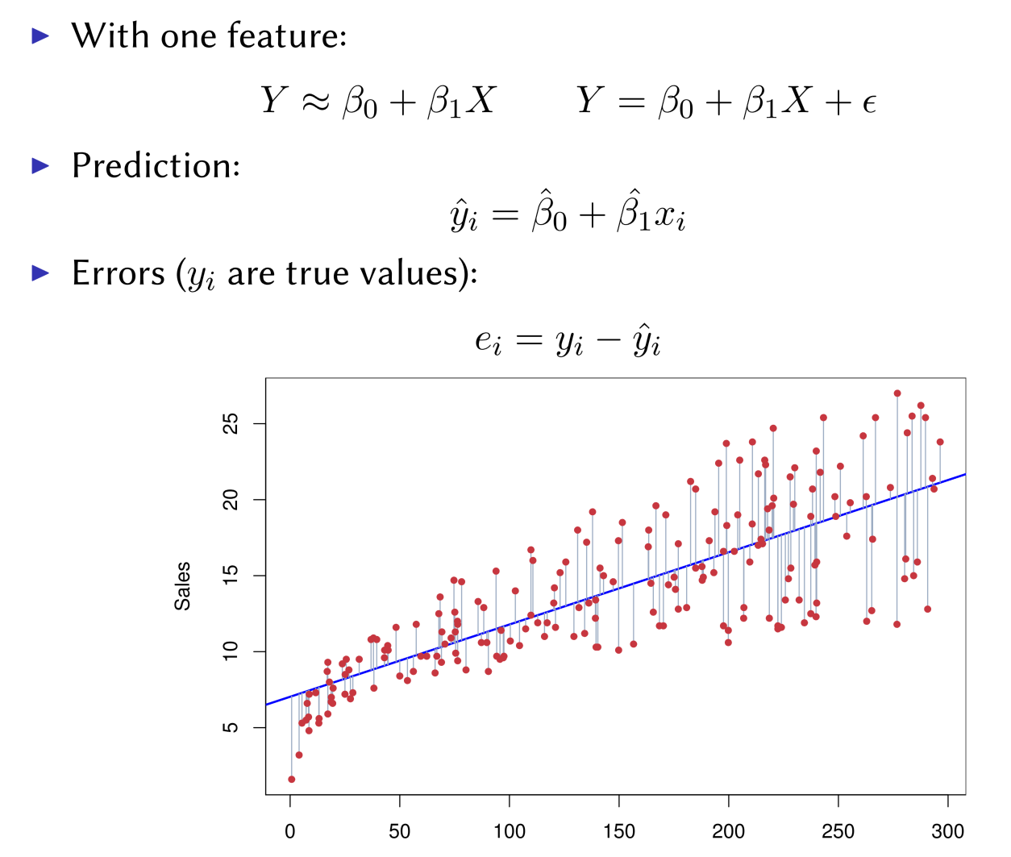
Recall: Linear Regression

Slide 27
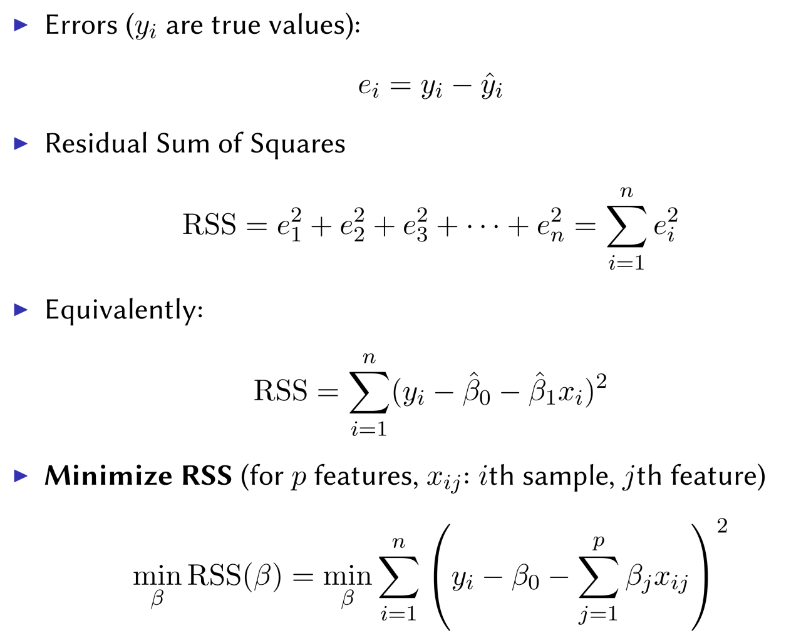
Recall: Linear Regression

Slide 28
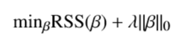
The Natural Way
This L0 norm is hard to optimize since it is not continuous.

Slide 29
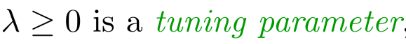
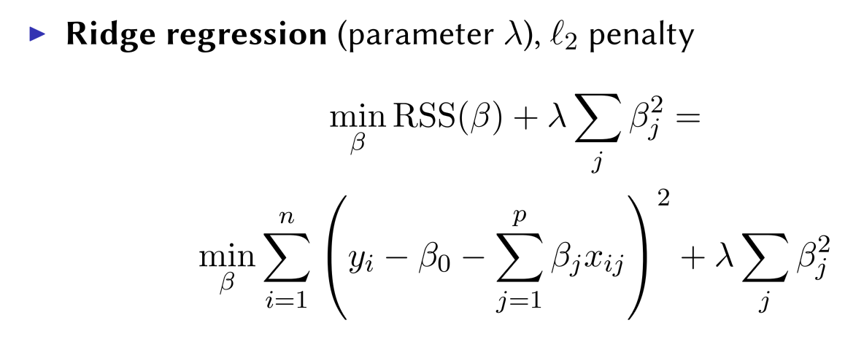
The Natural Way
Here
This L0 norm is hard to optimize since it is not continuous.
Relaxation the L0 norm

Slide 30
Final Project
Propose a dataset you want to analyze
Student will vote to choose the top 4 next Friday.
Each student complete a project using one of these four to analyze.
This project will require a written report due on someday.

Slide 31
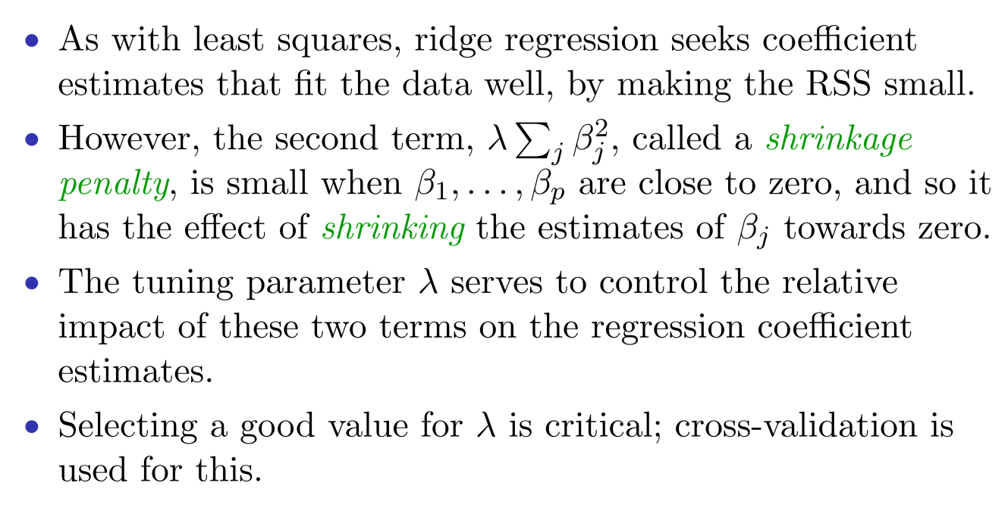
Ridge Regression

Slide 32
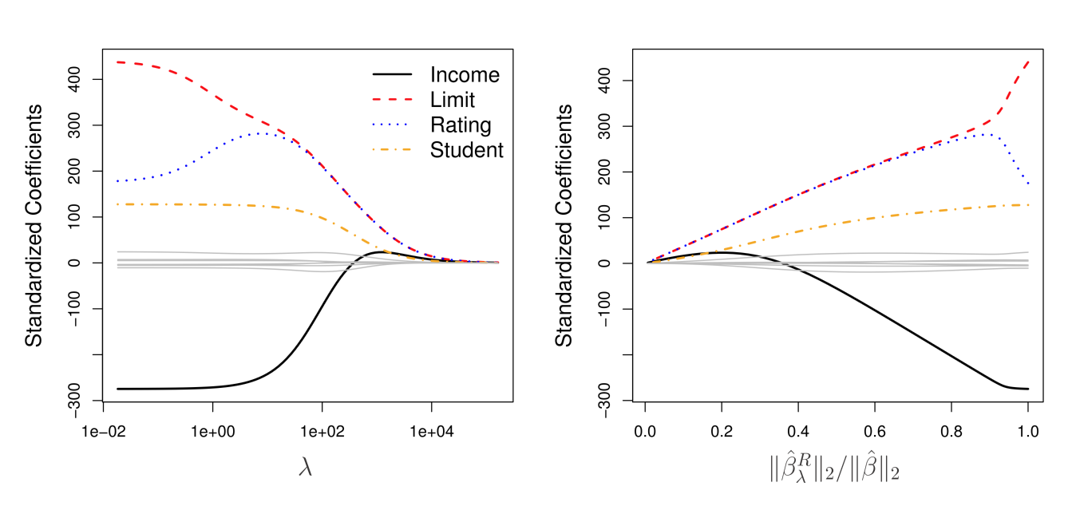
Credit Data

Slide 33
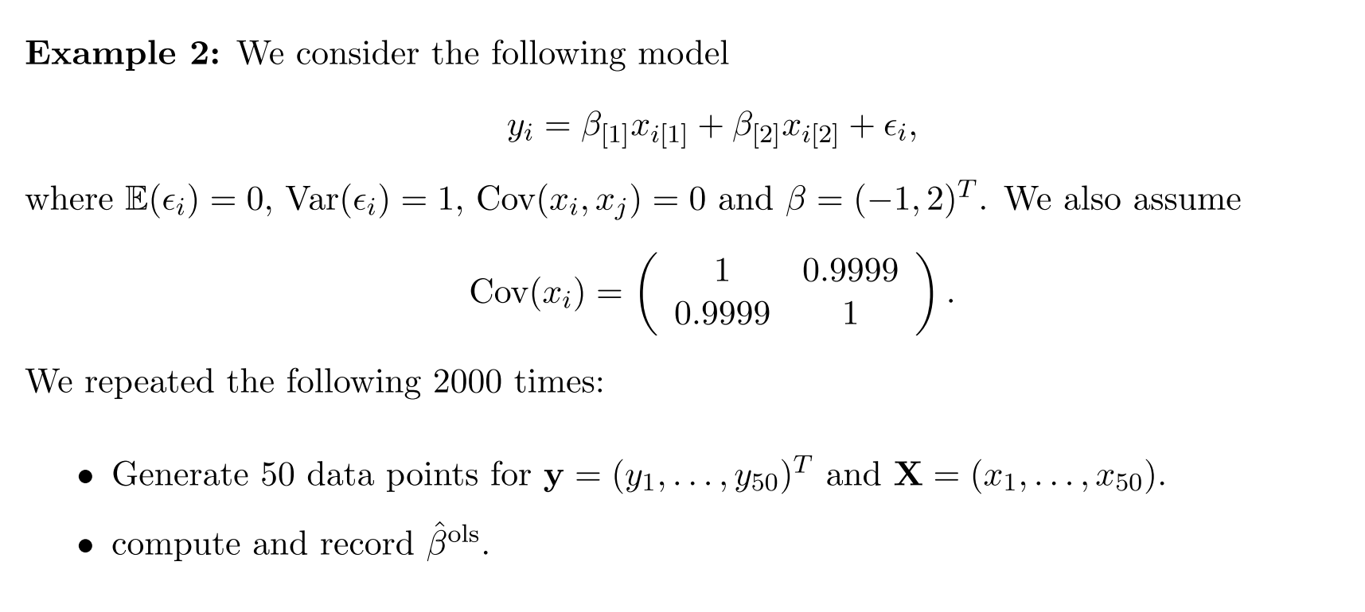
Ridge Regression for Estimates

Slide 34
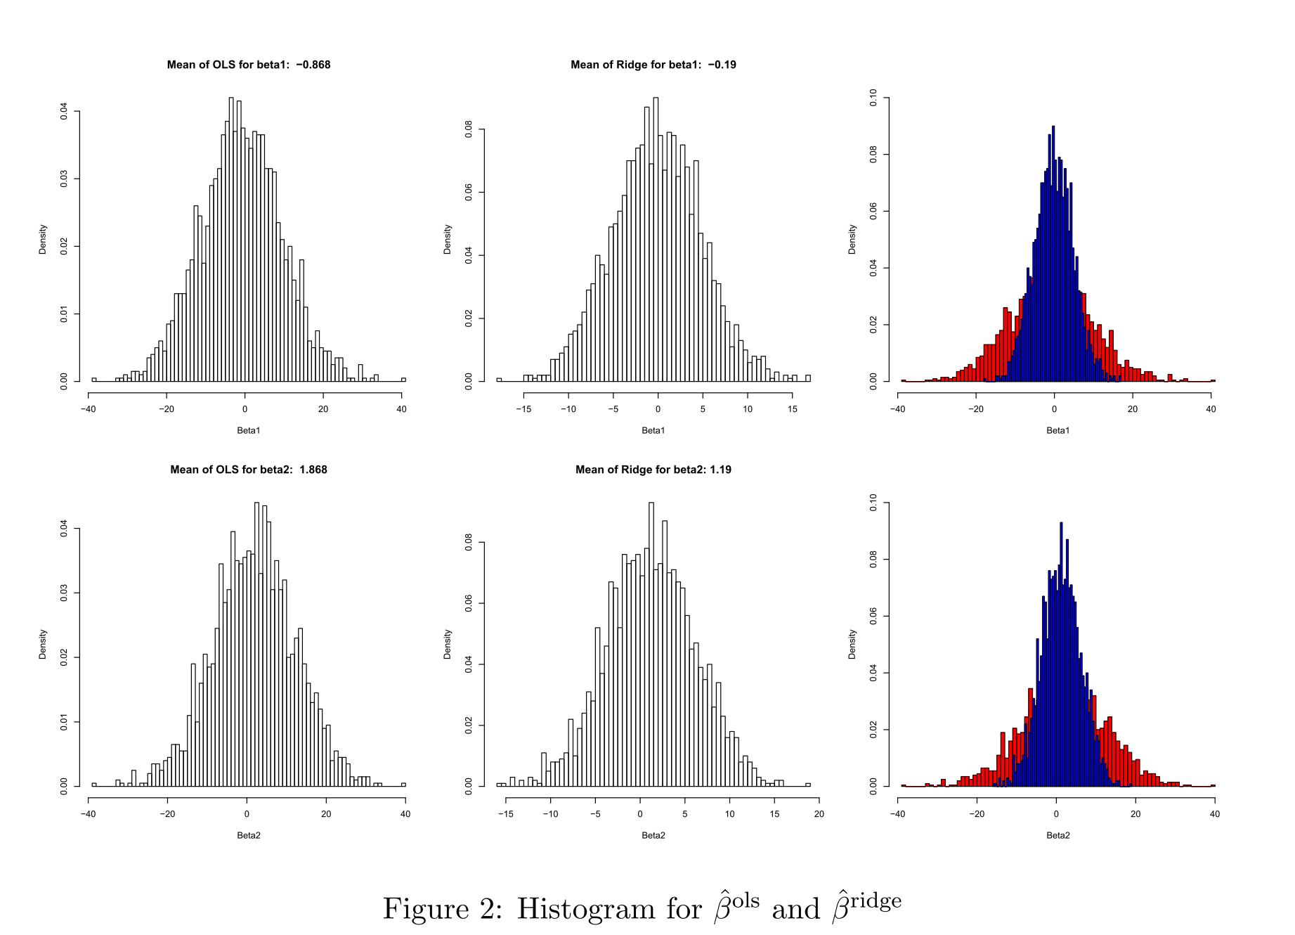
Ridge Regression for Estimates

Slide 35
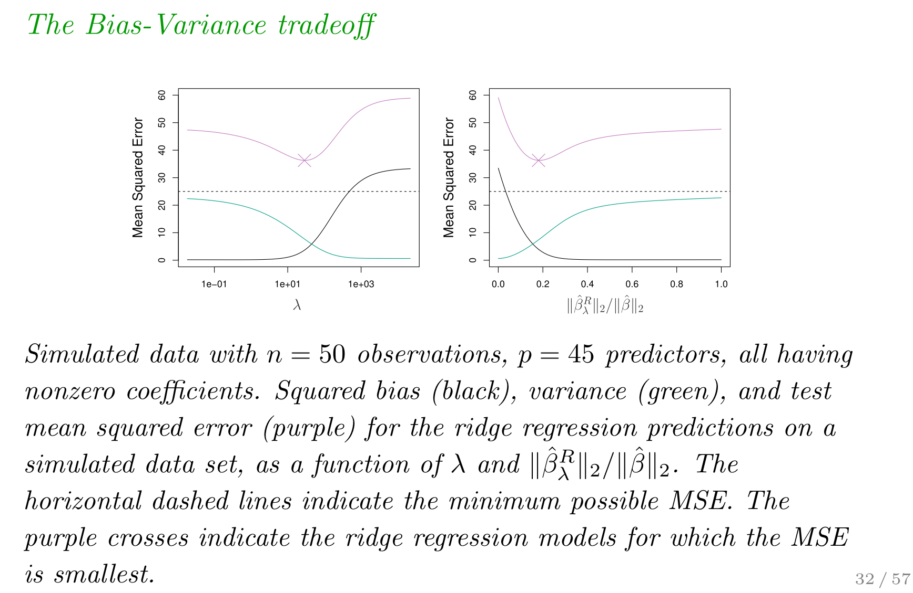
Ridge Regression: Simulation

Slide 36
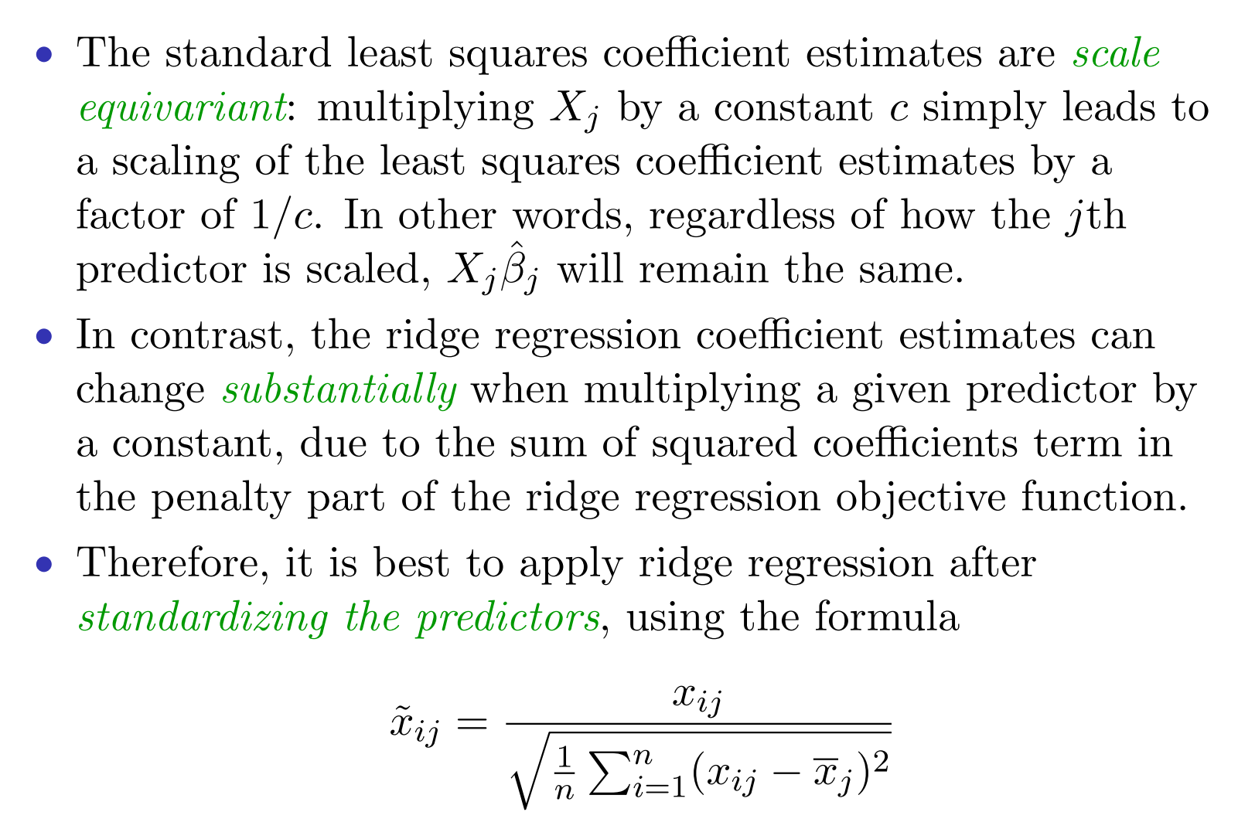
Ridge Regression: Scaling

Slide 37
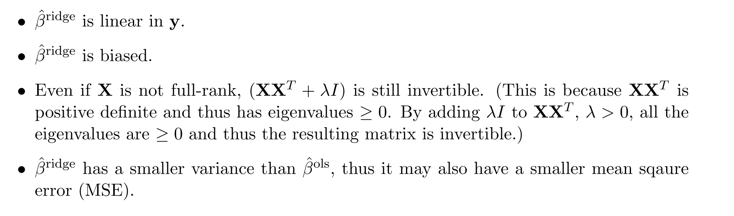
Ridge Regression

Slide 38
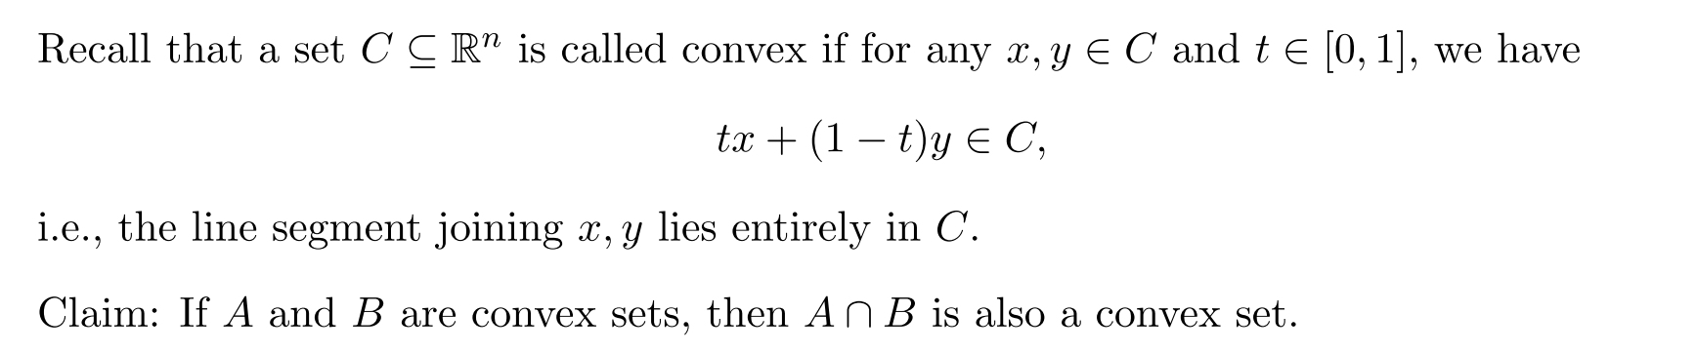
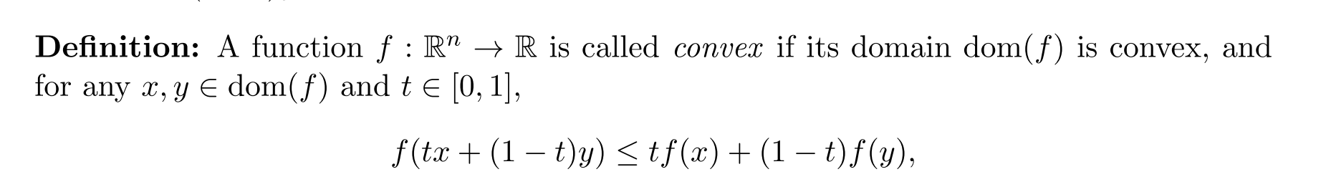
Convexity

Slide 39
Convexity
For a convex function, any local minimizer is also the global minimizer!

Slide 40
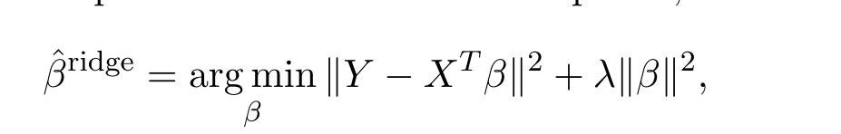
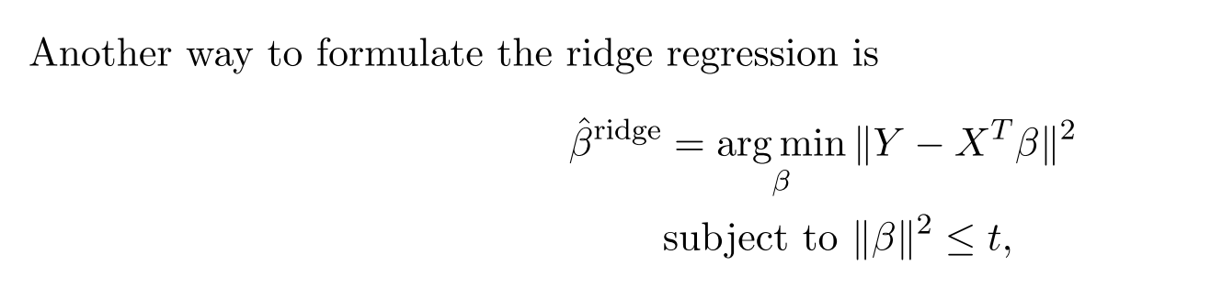
Constrained form of Ridge regression

Slide 41
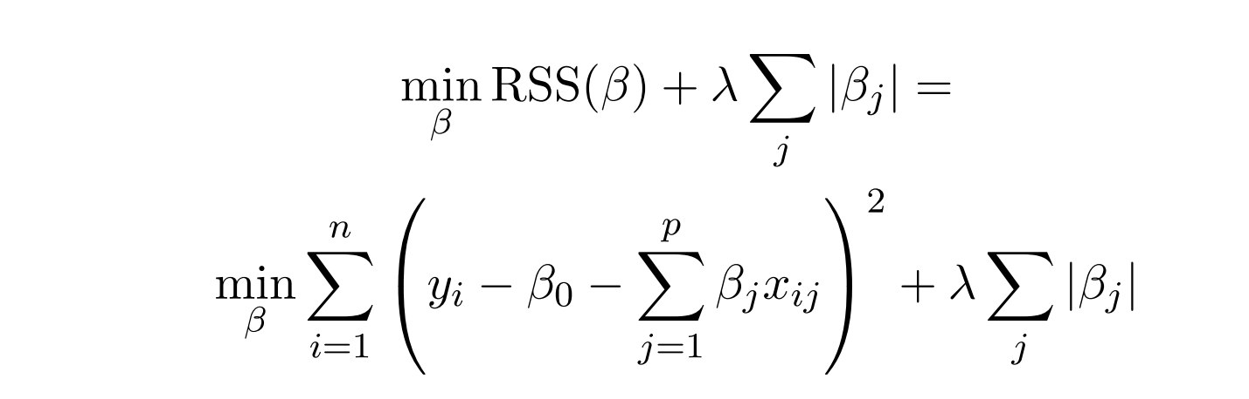
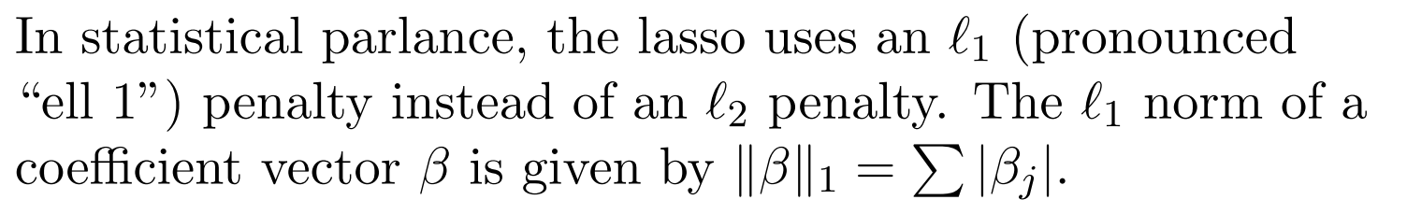
The LASSO Regression
Ridge regression will include all p predictors in the final model.
The Lasso regression can lead to a sparse model.

Slide 42
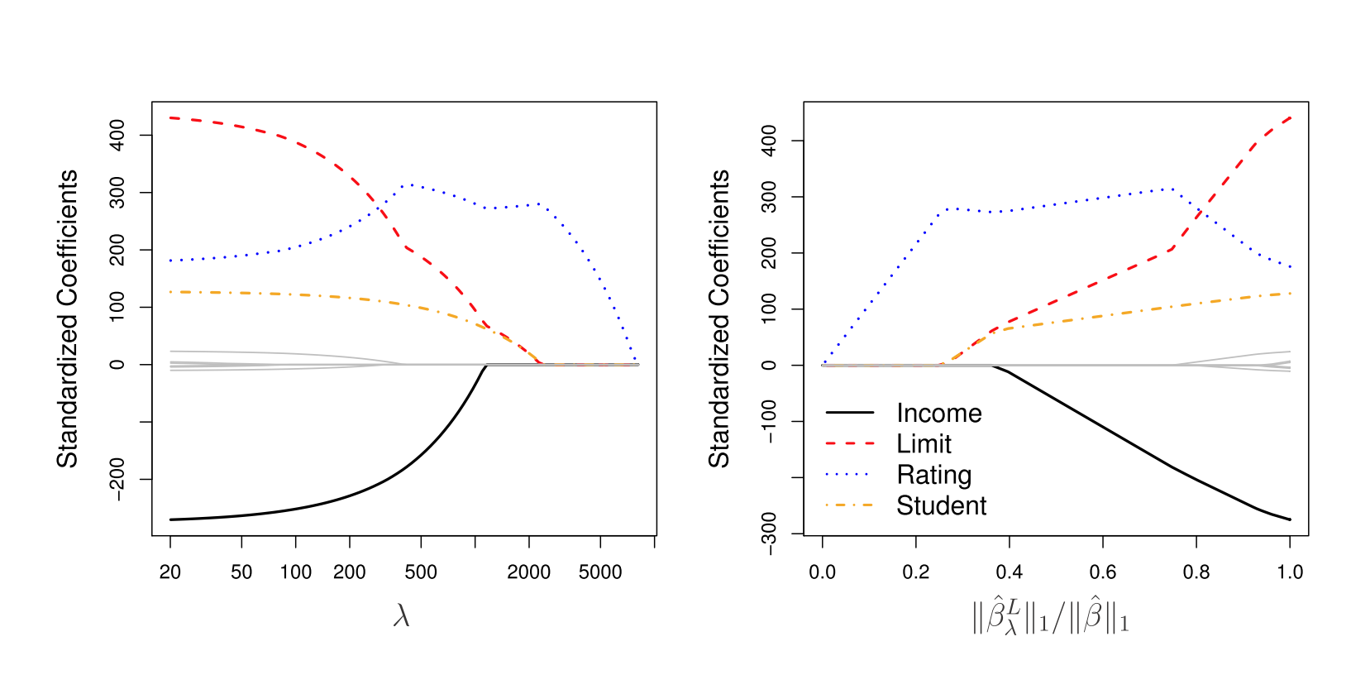
Credit Data

Slide 43
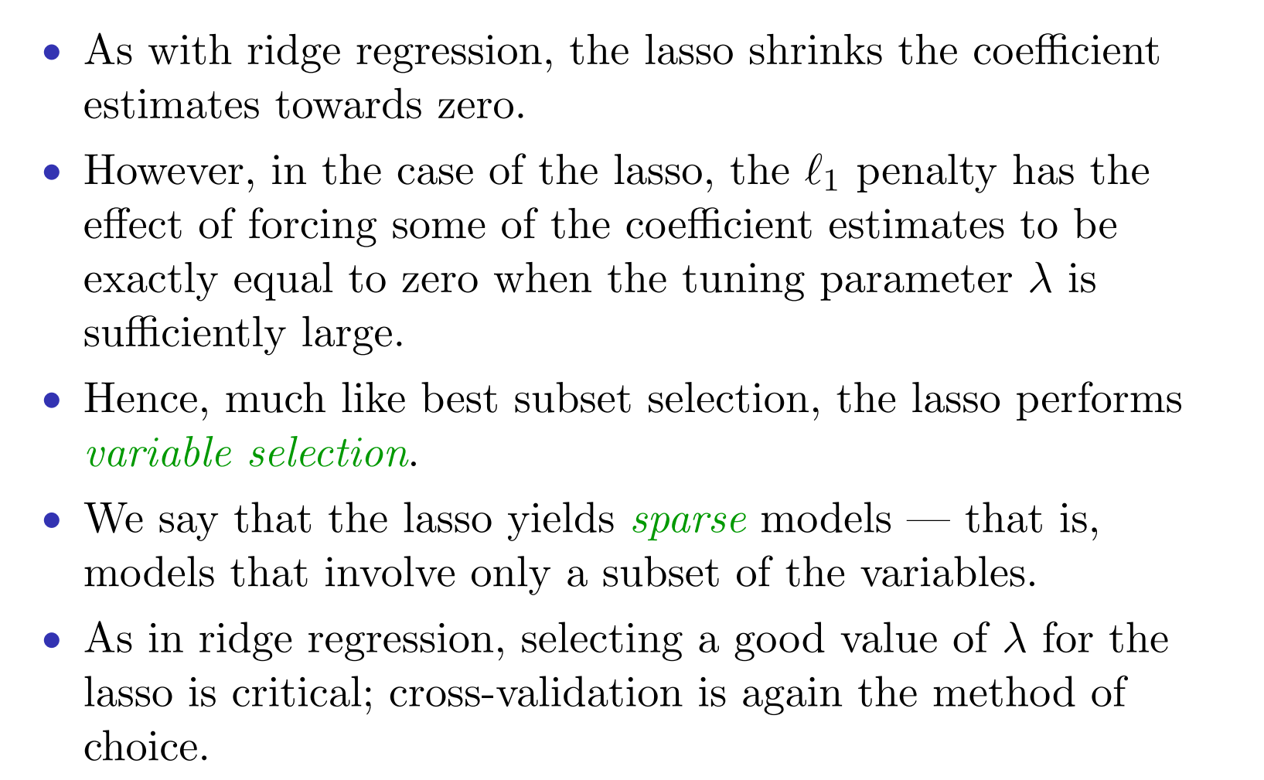
Lasso

Slide 44
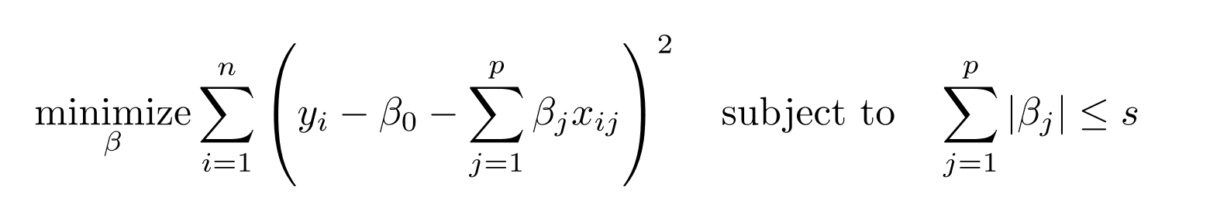
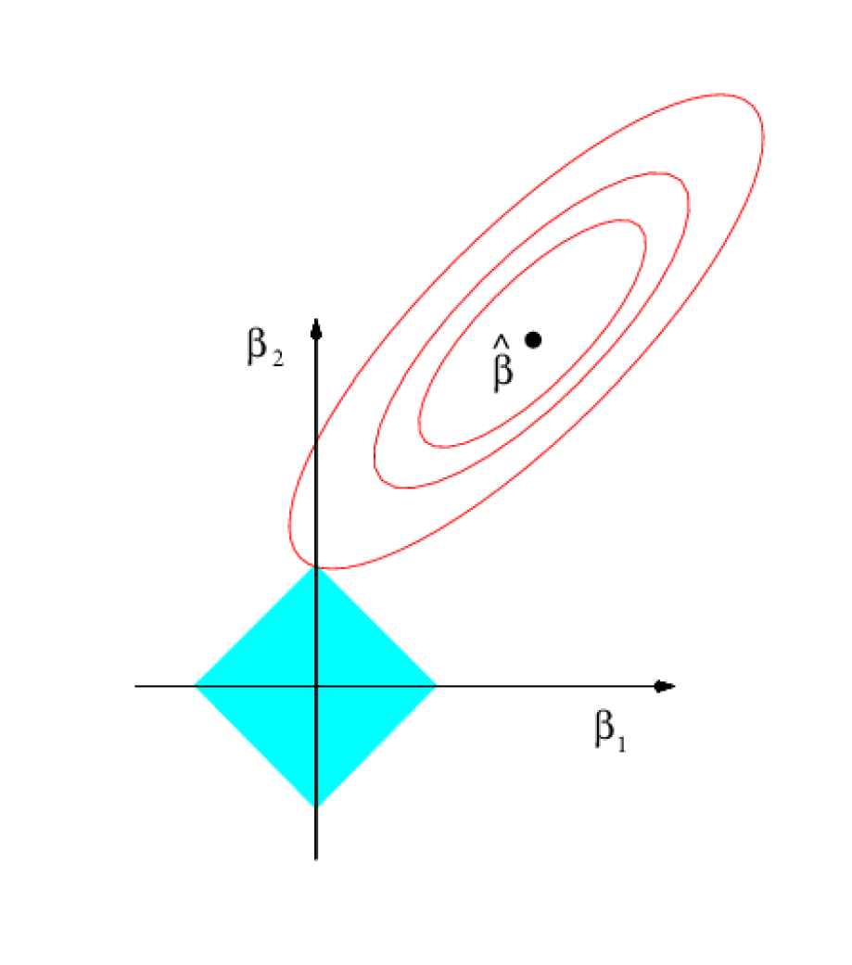
The Variable Selection of Lasso
The constrained version of Lasso

Slide 45
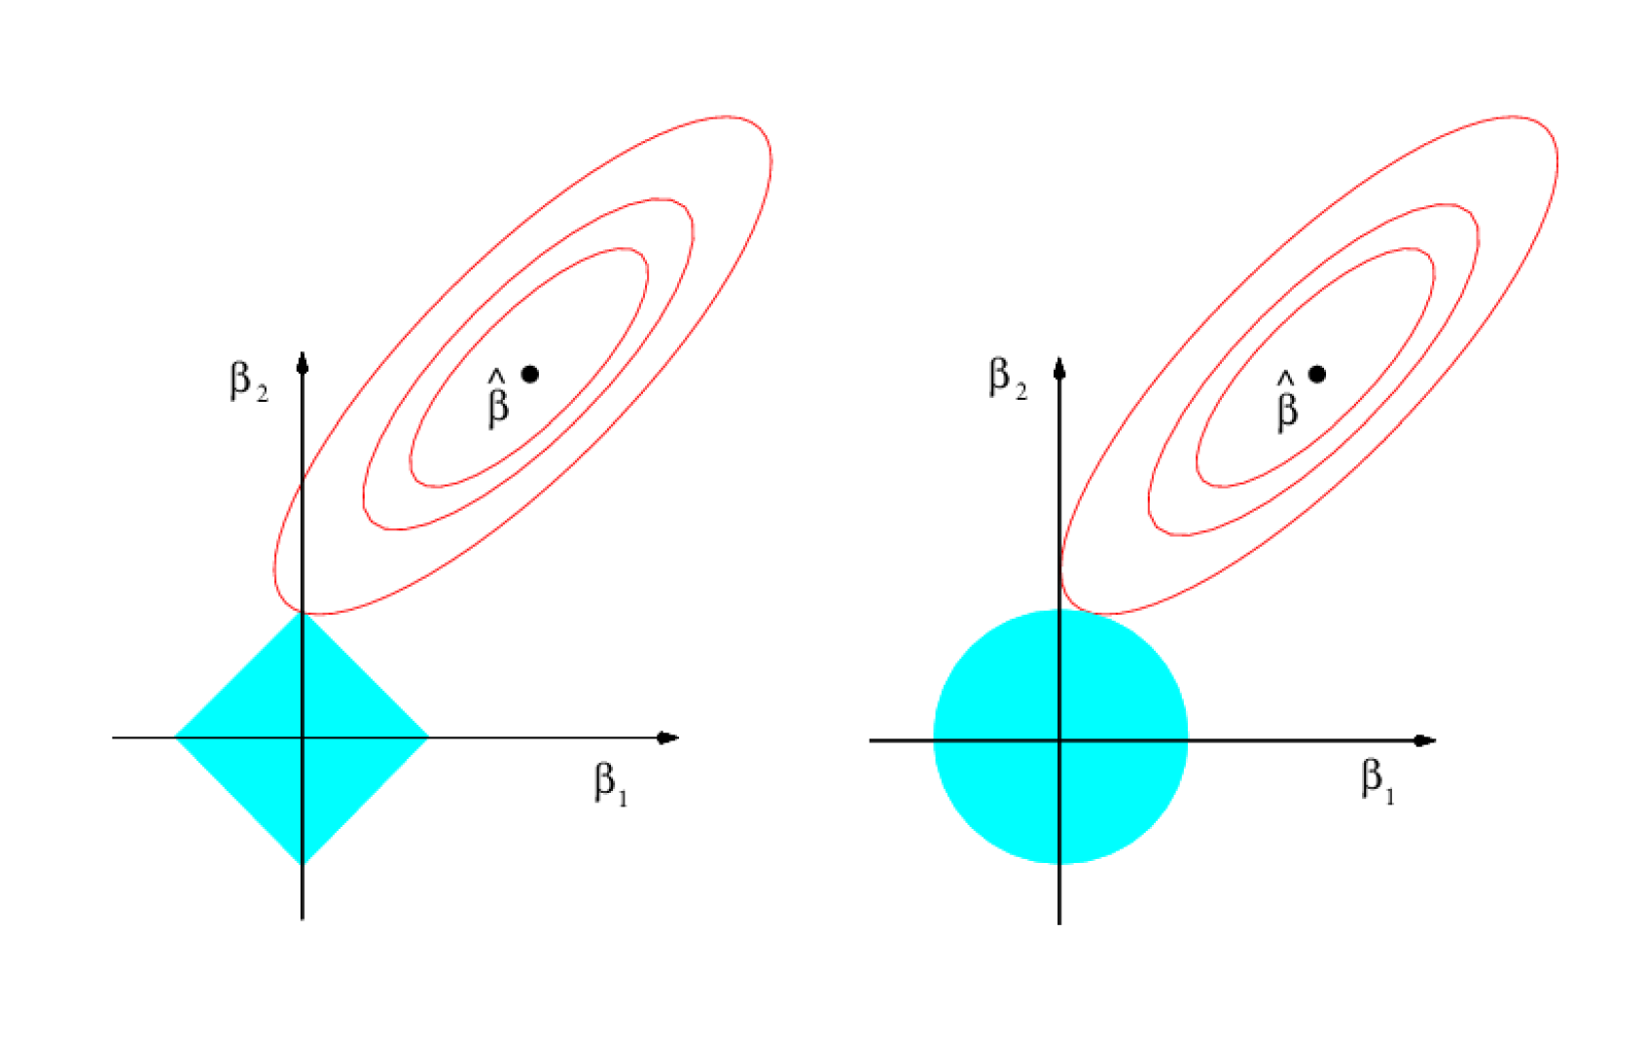
Lasso and Ridge

Slide 46
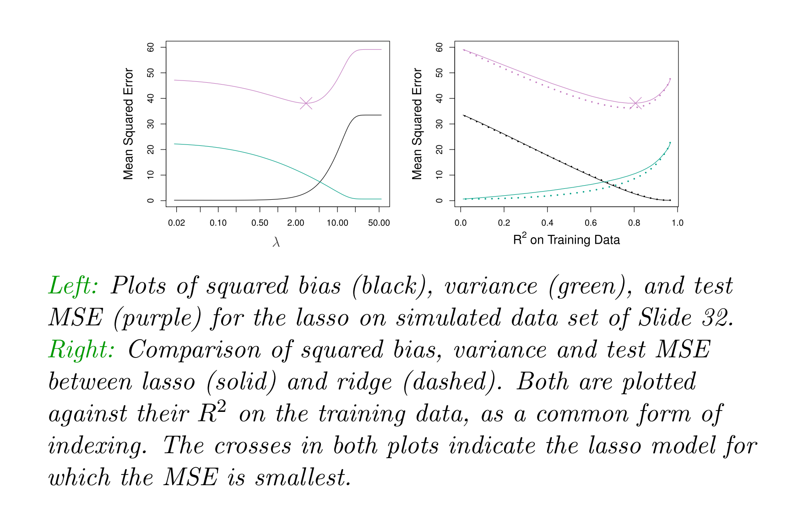
Lasso vs Ridge

Slide 47
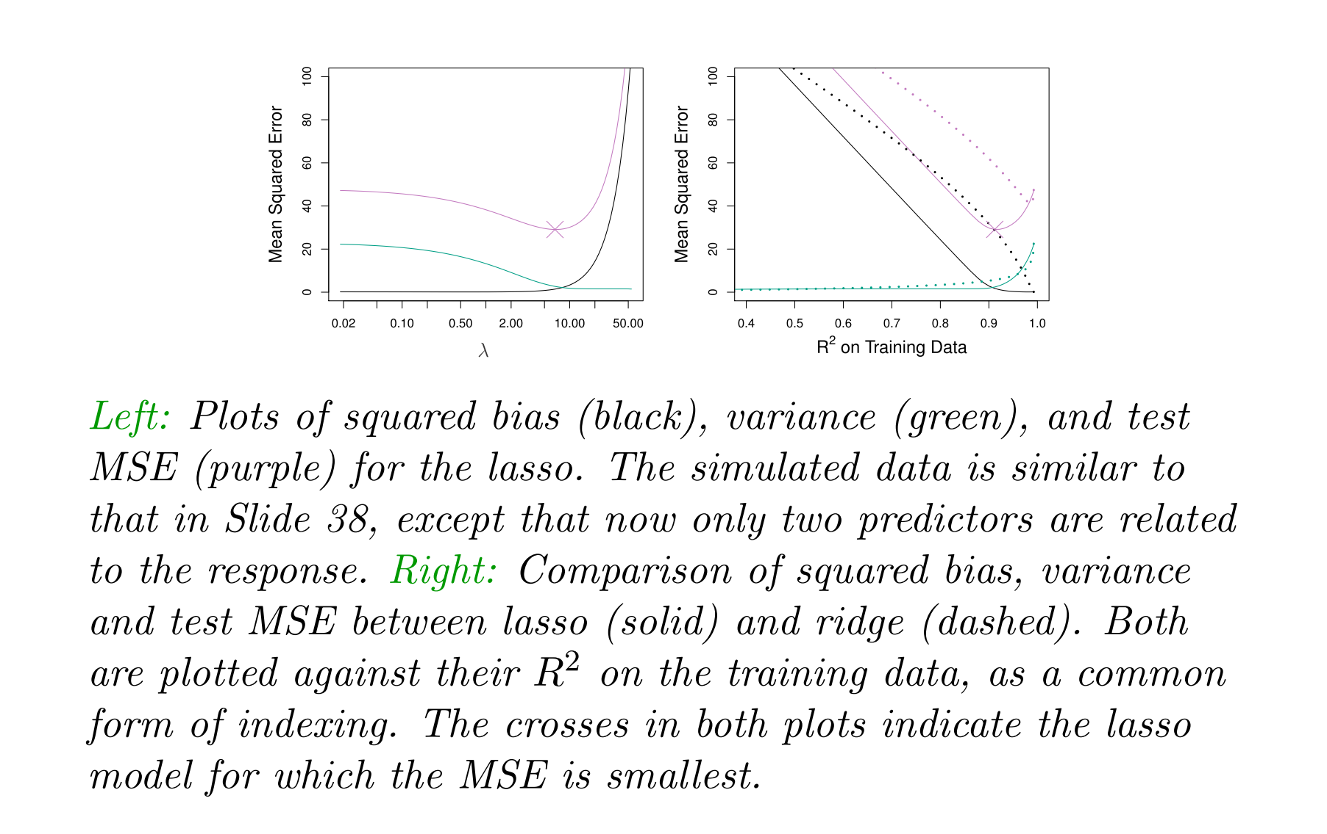
Lasso vs Ridge

Slide 48
Lasso vs Ridge
Neither can dominate the other. Depends on the data.
If only a small proportion of predictors are related to the response, then Lasso wins. (We never know)
We can use cross-validation to determine

Slide 49
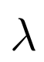
Tuning Parameters
Both Ridge and Lasso have a tuning parameter.
We can use Cross-validation to tackle this.
Choose a grid of values
Compute the cross-validation error for each value of
Pick the tuning parameter value with the smallest CV error.
Re-fit the model using all of the data and the selected value of

Slide 50
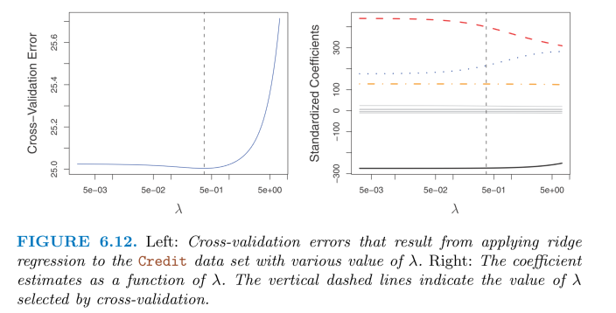
Credit Data

Slide 51
Credit Data

Slide 52
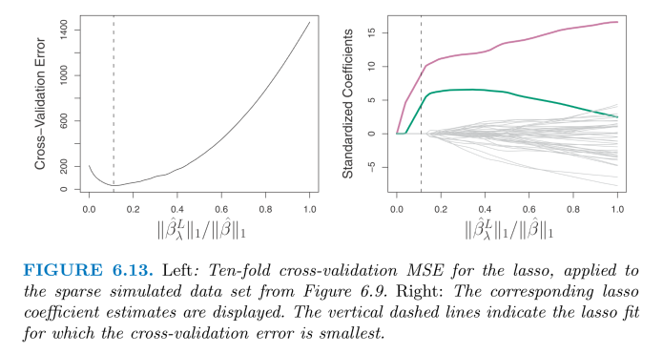
Simulated Data

Slide 53
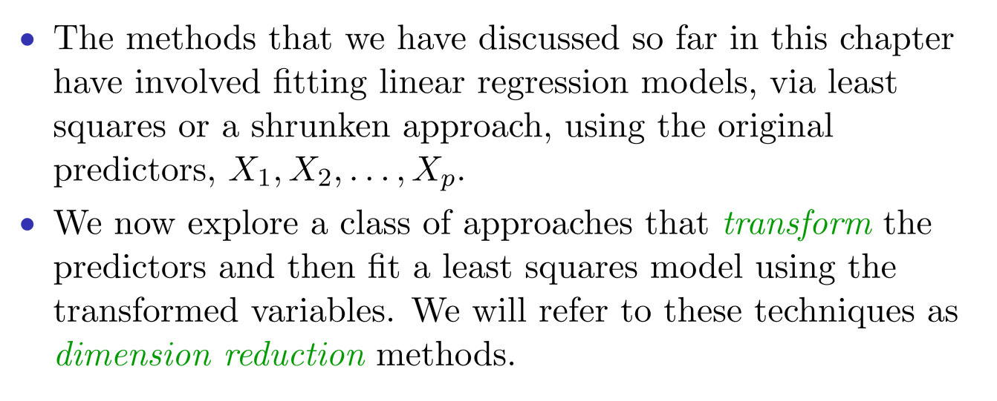
Dimension Reduction Methods

Slide 54
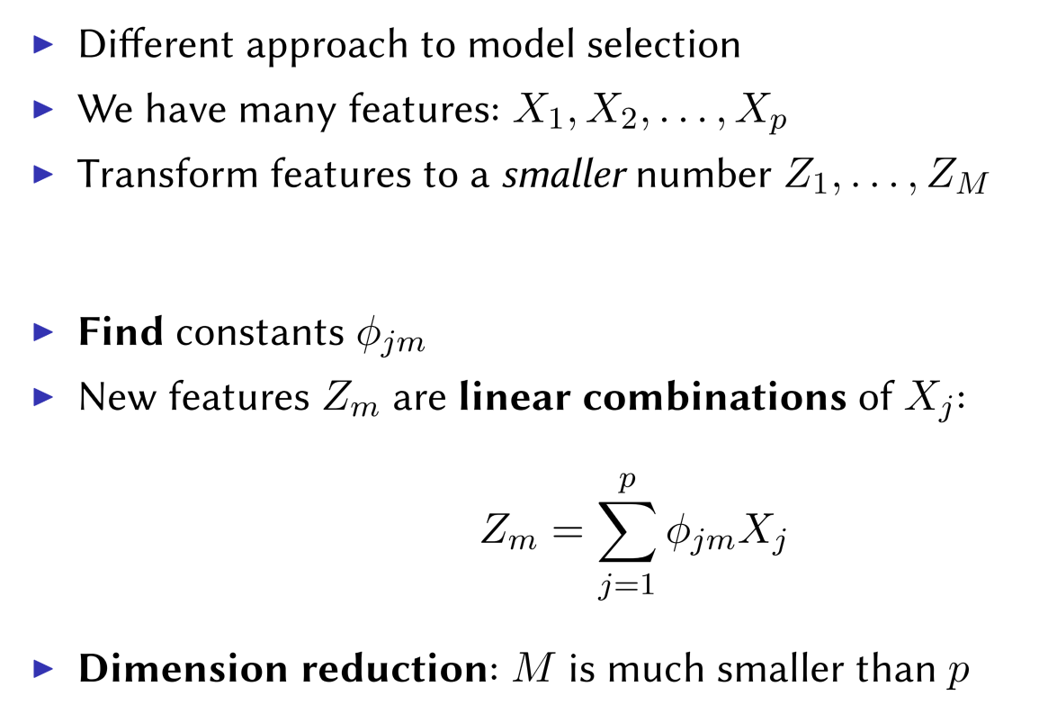
Dimension Reduction Methods

Slide 55
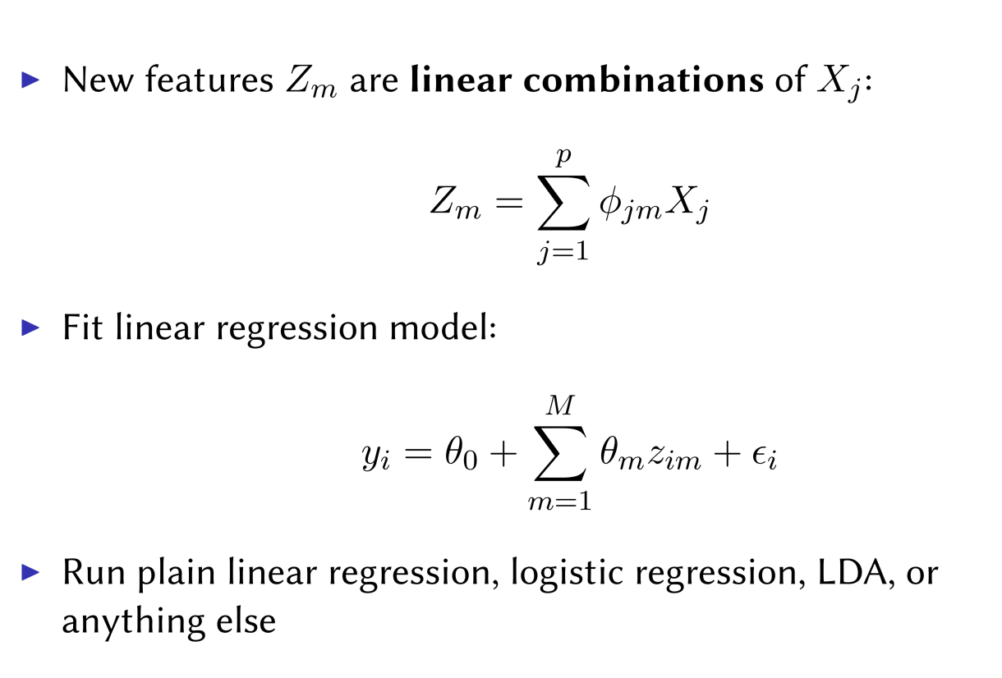
Using Transformed Features

Slide 56
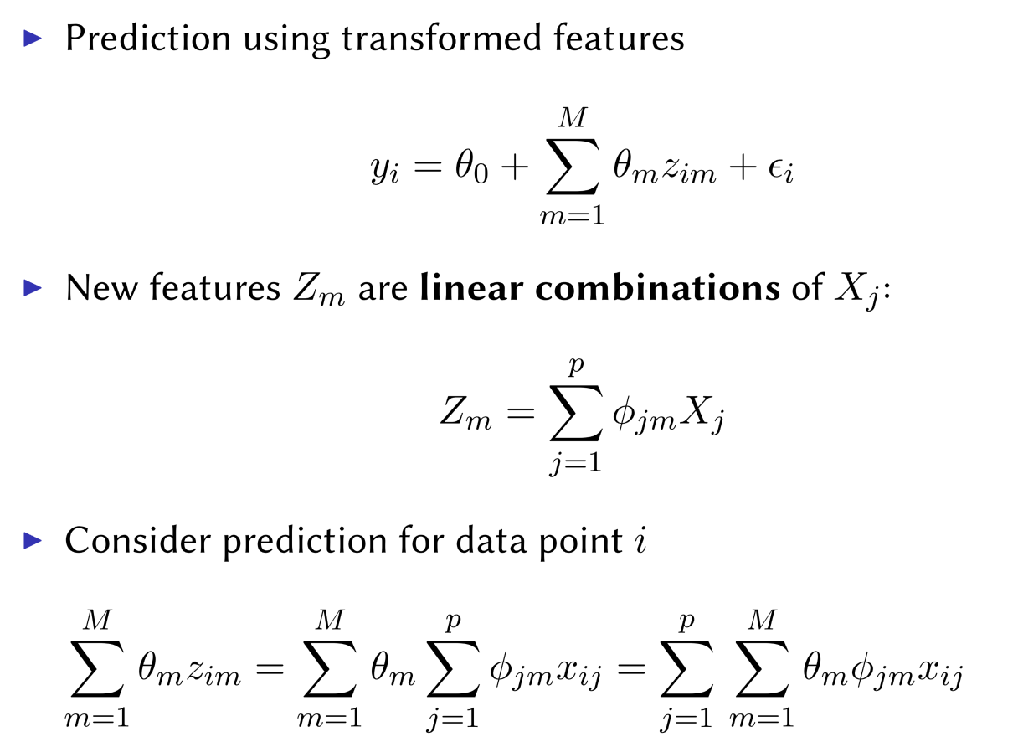
Recovering Coefficients for Original Feature

Slide 57
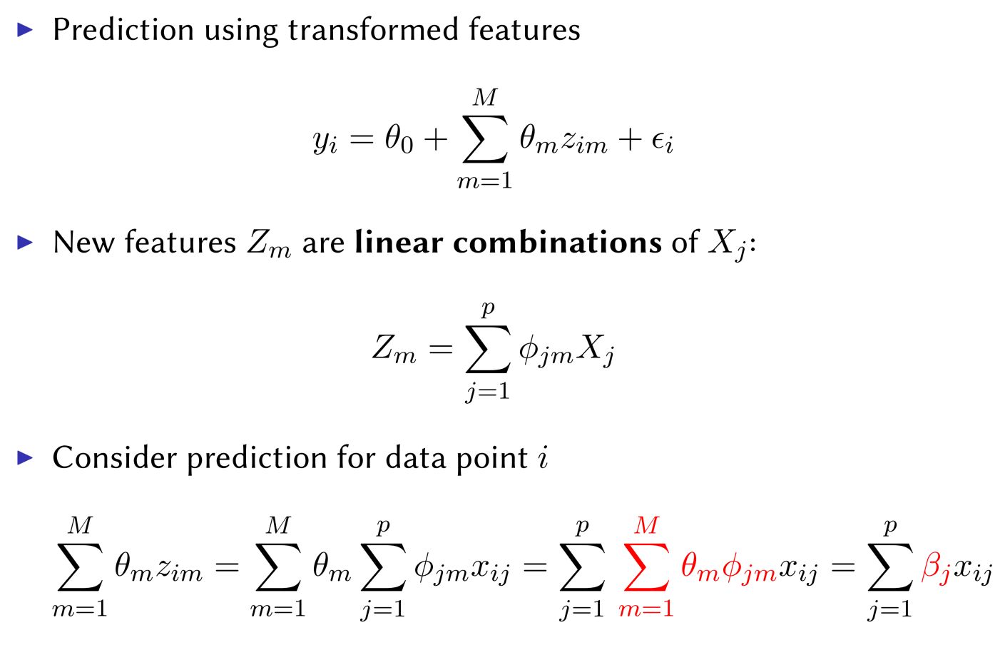
Recovering Coefficients for Original Feature

Slide 58

Dimension Reduction

Slide 59

How to Reduce Features?

Slide 60

PCA

Slide 61


PCA

Slide 62

The Second Principal Component

Slide 63

Principal Components

Slide 64

Principal Component Regression (PCR)

Slide 65

PCR vs Ridge and Lasso

Slide 66

Credit Data

Slide 67

Partial Least Square

Slide 68

Partial Least Square

Slide 69

Bonus Quiz 20
Compute and record for lambda = 0.01
Count how many times ridge estimates have a smaller error than the least square estimates.

Slide 70
Bonus Quiz 21
Comparing the training data MSE between ordinary least square, Ridge regression (lambda = 0.1), and Lasso (lambda = 0.01), which method has the smallest training error?

